Slide 1



Questions for audience
Have you ever seen a software library getting abandoned?
Have you ever noticed any early sign in a library before getting abandoned?
Notes:
So many excellent works on vulnerabilities! Let’s shift the gear and look something different and interesting!
I have two questions for you!
Have you sever seen a software library dying?
Have you ever noticed any early sign in that library before dying?
Well! That’s what we are going to see today!

Slide 2










Understanding Abandonment and Slowdown Dynamics in the Maven Ecosystem
Preprint available
Kazi Amit Hasan
Jerin Yasmin
Huizi Hao
Yuan Tian
Safwat Hassan
Steven H.H Ding
Notes:
That being said, I am happy to present one of my works ‘Understanding Abandonment and Slowdown Dynamics in Maven Ecosystem’, a collaboration of Queen’s UoT and McGil. This is me, Kazi Amit Hasan, a PhD student at Queen’s University. Let’s get started!

Slide 3








Understanding Abandonment and Slowdown Dynamics in the Maven Ecosystem
Motivation
OSS libraries are frequently adopted as dependencies in millions of OSS software systems.
Fast = quartile average is 20% less than overall average
Slow = quartile average is 20% longer than overall average
Normal = quartiles with intervals between fast and slow thresholds
Nan = quartile-specific average release lifespans cannot be calculated (either Q2 or Q3) , if no releases occur, and in Q4
Fast
Fast
Slow
Slow
Q1
Q2
Q3
Q4
One in four libraries survive beyond their creation year.
Notes:
open source libraries are frequently adopted as dependencies in millions of softwares
Imagine a library, with it’s lifespan divided into four quartiles, is very happy with many frequent releases initially in Q1, as days passed, number releases decreases and eventually, it gets slow in Q3 and fainted lastly in Q4.
Let’s try to quantify this with some terminologies: we are calling a particular quartile
Fast: quartile average is 20% less than overall average
Slow= 20% longer than overall average
Normal – anything that falls in between fast and slow threshold
Nan = if no release in the quartile
Now you understand the transitions among the quartiles
This is a typical scenario of one out of every four libraries which survive beyond their creation year. Which makes this problem very interesting.

Slide 4
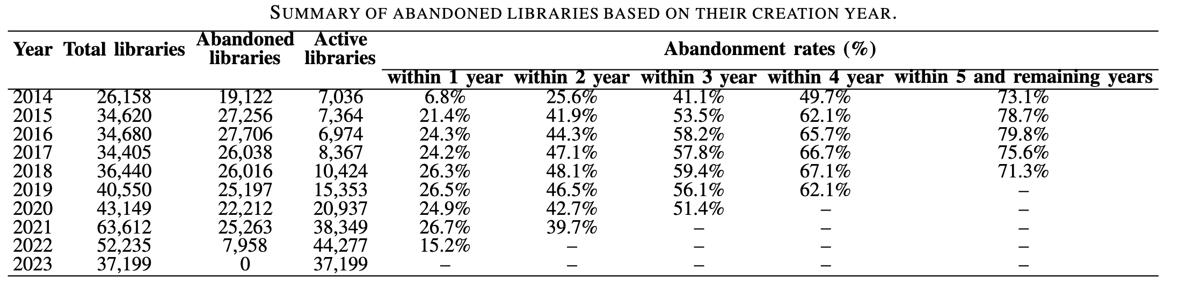
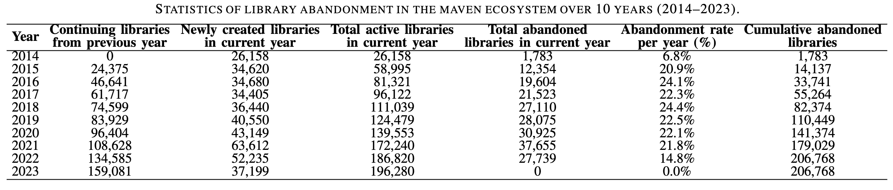
Understanding Abandonment and Slowdown Dynamics in the Maven Ecosystem
RQ1: What is the trend of abandonment over the years?
The number of abandoned libraries increased over time (from 20.9% to 24.4% during 2015 to 2021)
High first year abandonment (21.4 to 26.7%)
26.7% libraries couldn’t even make it their 2nd year.
Roughly one in four failing within their first year.
Notes:
From 2015 to 2021, we noticed increase in number of abandoned libraries each year, ranging around (20.9% to 24.4%)
When we tired to see yearly abandonment rate, we were surprised that 26.7% libraries couldn’t even make it to 2nd year, which means one out of four libraries are getting abandoned in their first year

Slide 5
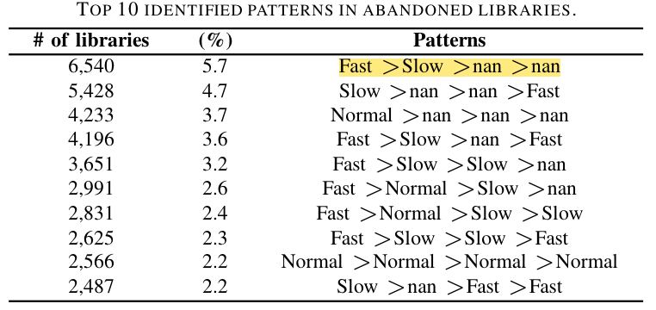
Understanding Abandonment and Slowdown Dynamics in the Maven Ecosystem
RQ2: What are the release activity patterns in abandoned versus active libraries?
Abandoned libraries already slowed down or have long relative inactive period before abandonment
12.8% of libraries recovered from slow release but still abandoned.
Temporal increase in release activity is insufficient to prevent abandonment.
Notes:
The first pattern confirms our usual intuition that abandoned libraries are already slowed down.
Interestingly, there’s a total of 12.8% libraries where they recovered from slow release in their last quartile but still get abandoned. This suggests that a temporary increase in release activity is insufficient to prevent abandonment.

Slide 6





Understanding Abandonment and Slowdown Dynamics in the Maven Ecosystem
Implications
Monitor dependency release activity
Kazi Amit Hasan
kaziamit.hasan@queensu.ca
Watch for sudden slowdowns and temporal high activity
Package platforms could introduce automated alerts based on quartile speeds
Thank you! Any questions are welcomed!
Scan to vote
Notes:
Now, our recommendation for partitioners are:
Monitor your dependency release activity.
You should watch for sudden slowdowns or increased release
3. Developers can introduced automated alerts for the slowdowns.
That’s it! We just saw how a library gets abandoned! Thanks for being with me!

